Slide 1
OPENCV 적용안
19100179 임준형

Slide 2
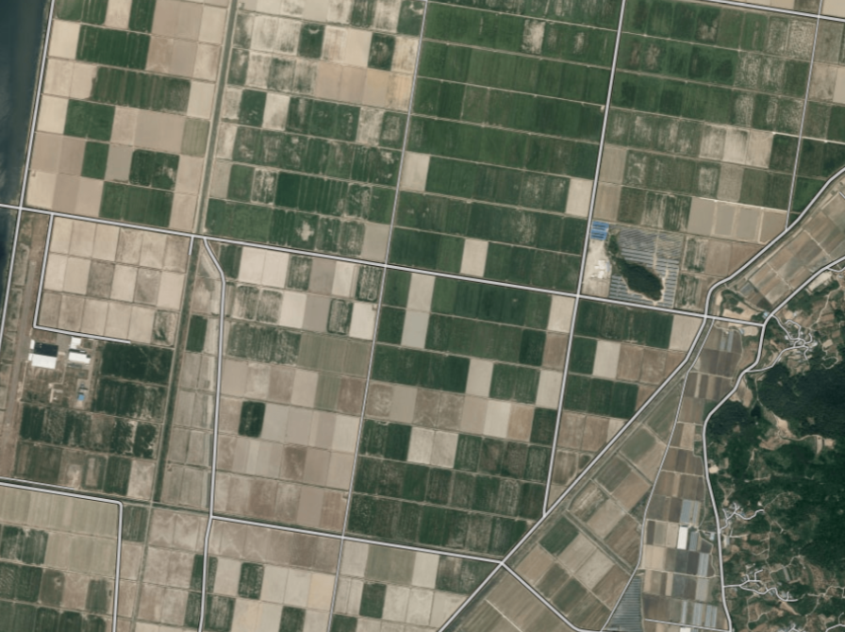
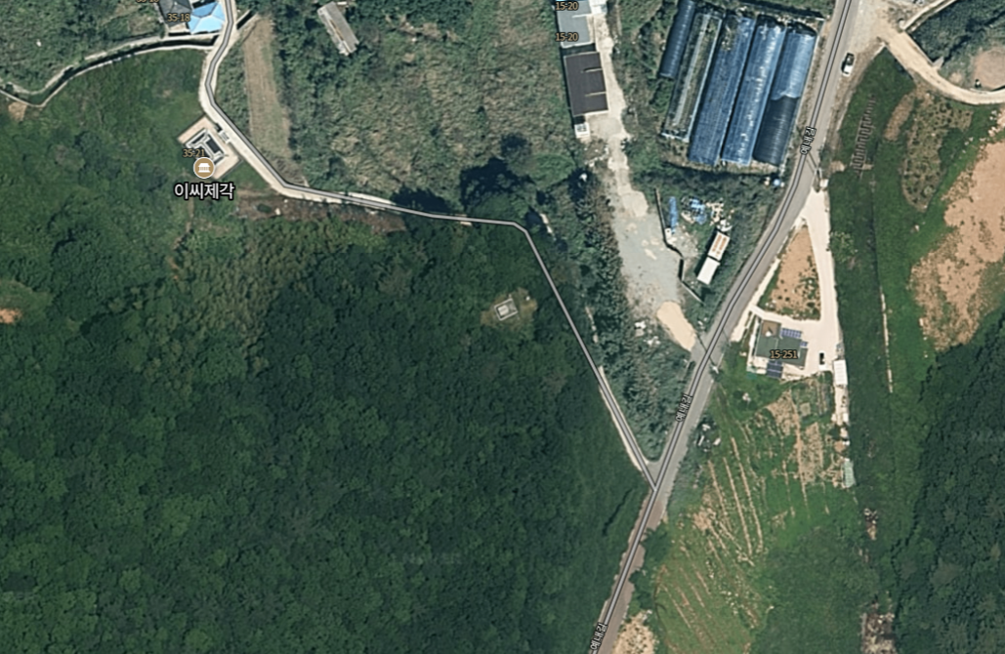
OPENCV with python
☺ opencv를 활용하기 위해 발사 위치를 특정하기 위해서 youtube영상을
참고하여 발사 예측장소 특정하기.
☺ opencv step
1.gaussian smoothing
2.gradient(magnitude)
3.gradient in x
4.gradient in y
5.non-maximum suppression
6.hysteresis threshold
road1
road2

Slide 3
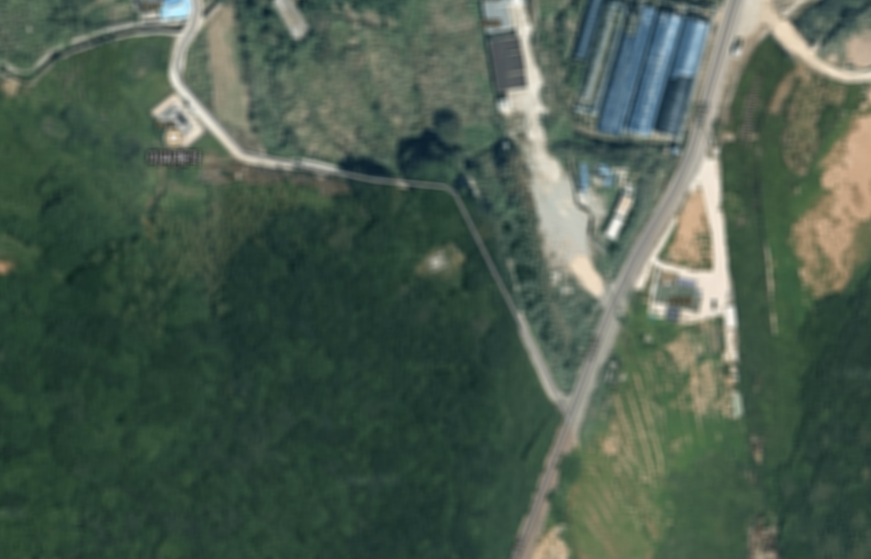
예시 <흐림효과 처리>
import cv2
src = cv2.imread("Image/geese.jpg", cv2.IMREAD_COLOR)
dst = cv2.blur(src, (9, 9), anchor=(-1, -1), borderType=cv2.BORDER_DEFAULT)
cv2.imshow("dst", dst)
cv2.waitKey()
cv2.destroyAllWindows()

Slide 4
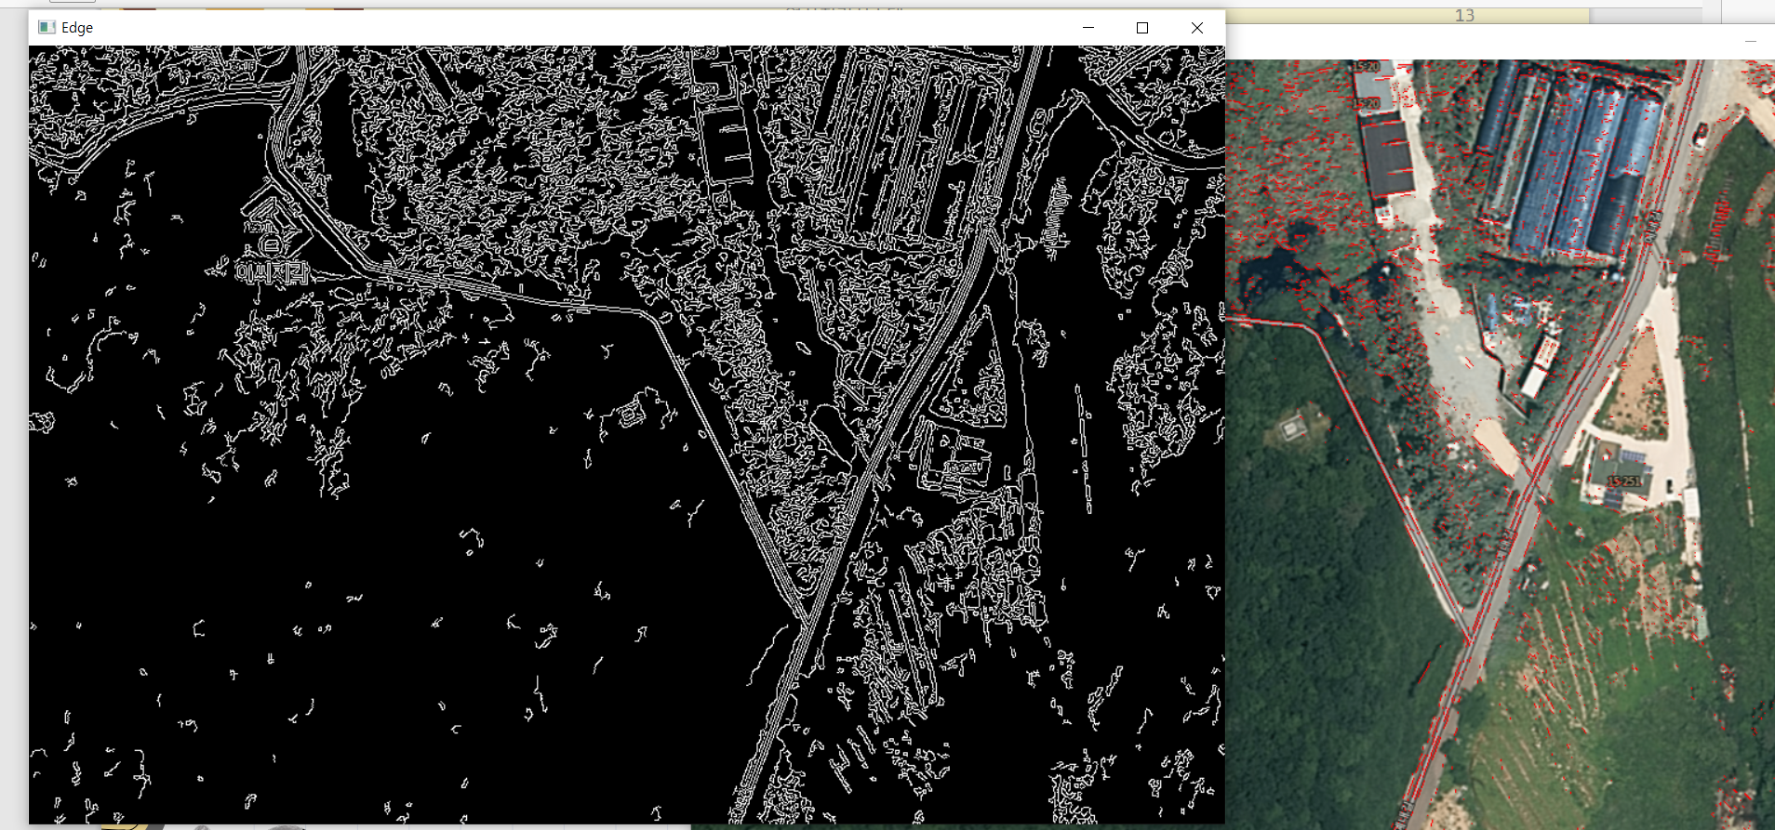
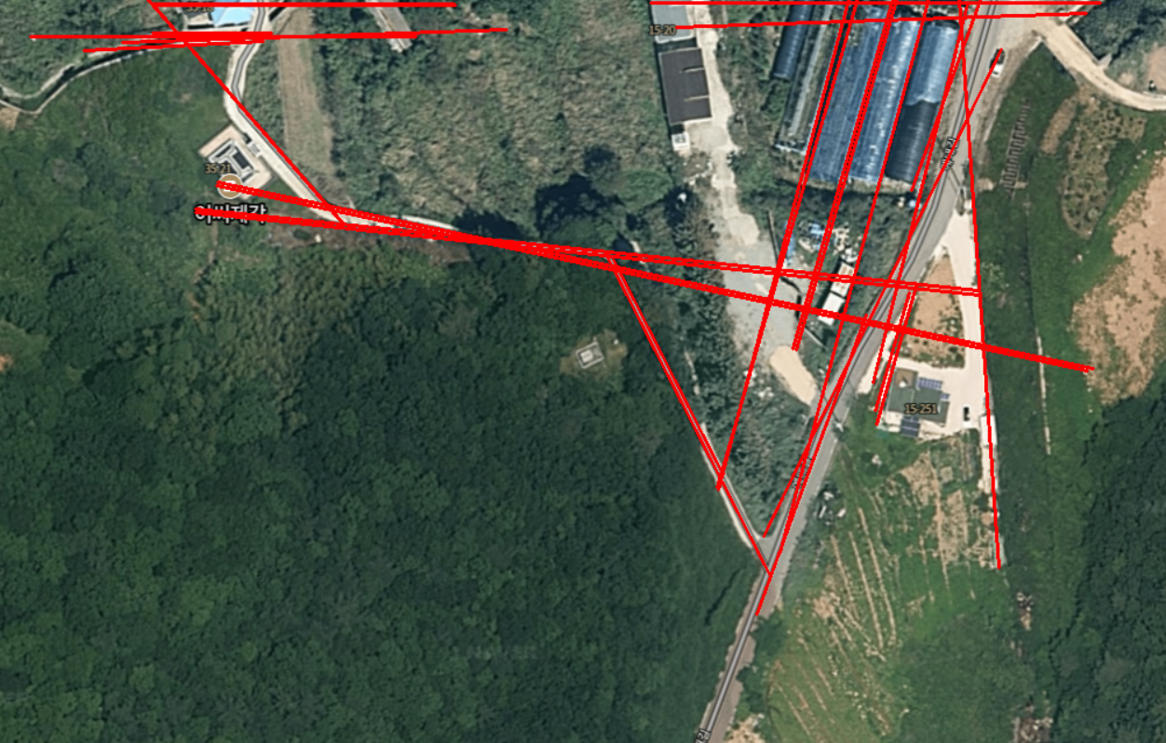
하프변환
직선검출

Slide 5
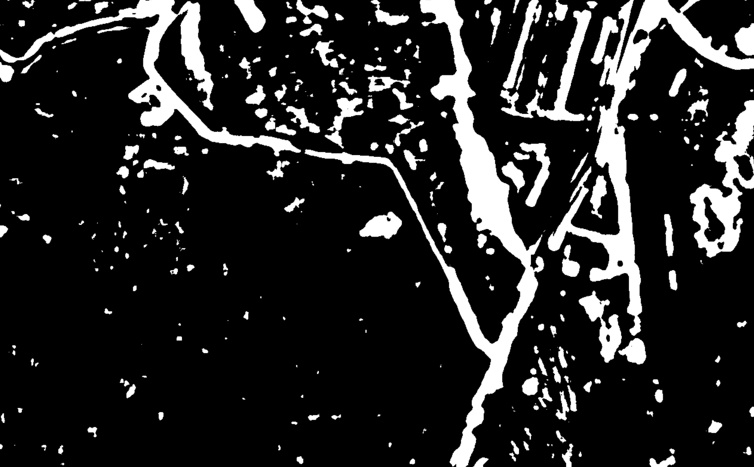
<실제 사진>
< 흐림처리후 적응형 이진화>

Slide 6
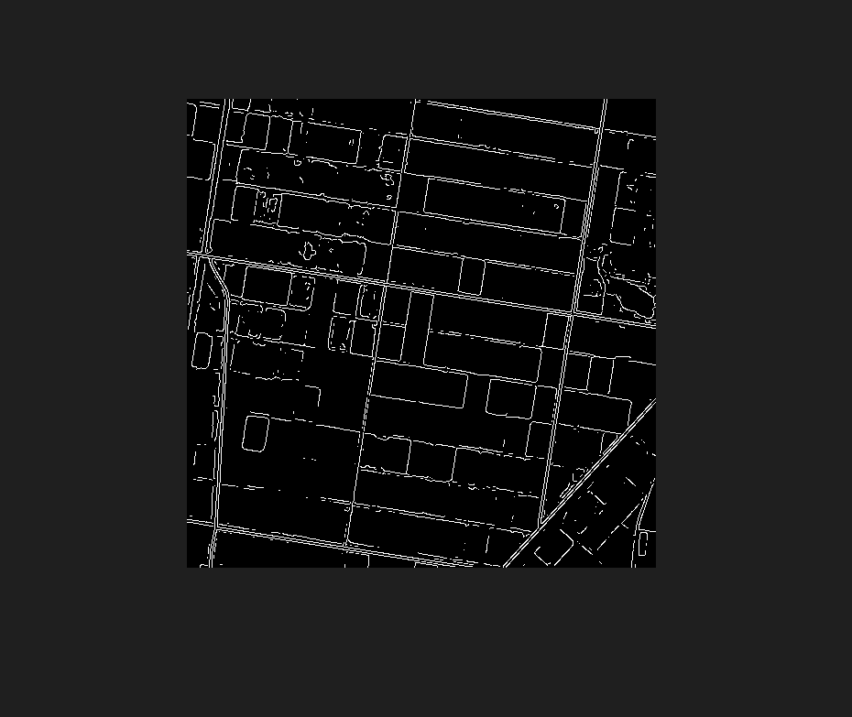
<실제사진>
<6단계 변환 후 결과물>

Slide 7
<직선검출>
import numpy as np
import cv2
src = cv2.imread("imgg/road.png")
dst = src.copy()
gray = cv2.cvtColor(src, cv2.COLOR_BGR2GRAY)
canny = cv2.Canny(gray, 5000, 1500, apertureSize = 5, L2gradient = True)
lines = cv2.HoughLinesP(canny, 0.8, np.pi / 180, 90, minLineLength = 10, maxLineGap = 100)
for i in lines:
cv2.line(dst, (int(i[0][0]), int(i[0][1])), (int(i[0][2]), int(i[0][3])), (0, 0, 255), 2)
cv2.imshow("dst", dst)
cv2.waitKey(0)
cv2.destroyAllWindows()
<허프>
import cv2
import numpy as np
img= cv2.imread('imgg/road.png')
gray = cv2.cvtColor(img,cv2.COLOR_BGR2GRAY)
edges = cv2.Canny(gray,80,200,apertureSize =3)
lines = cv2.HoughLinesP(edges,1,np.pi/180,150)
lines =lines.reshape((-1,4))
for x1,y1,x2,y2 in lines:
cv2.line(img,(x1,y1),(x2,y2),(0,0,255),1)
cv2.imshow('Edge',edges)
cv2.imshow('Line',img)
cv2.waitKey(0)
cv2.destroyAllWindows()
<적응형 이진화>
import cv2
src = cv2.imread("imgg/road.png")
gray = cv2.cvtColor(src, cv2.COLOR_BGR2GRAY)
binary = cv2.adaptiveThreshold(gray, 255, cv2.ADAPTIVE_THRESH_GAUSSIAN_C, cv2.THRESH_BINARY, 501, -30)
cv2.imshow("binary", binary)
cv2.waitKey(0)
cv2.destroyAllWindows()
<흐림효과>
import cv2
src = cv2.imread("Image/geese.jpg", cv2.IMREAD_COLOR)
dst = cv2.blur(src, (9, 9), anchor=(-1, -1), borderType=cv2.BORDER_DEFAULT)
cv2.imshow("dst", dst)
cv2.waitKey()
cv2.destroyAllWindows()

